Slide 1


Numerical Investigation of the
Thrust Vectoring Performance of
Bypass Dual Throat Nozzle
-
Aero thermochemistry And Combustion
202450268
Ha, Taerin
TURBO PROPULSION LAB.

Slide 2
Introduction
Nozzle configuration
Computational method
Results and Discussion
conclusions
Contents

Slide 3
Introduction
Research Overview
Stealth and supersonic flight technology are essential requirements for future fighter jets
Excellent maneuverability in supersonic flight
High angle of attack, high altitude flight possible
Capable of performing missions in vertical maneuvers and short takeoff and landing distances
→ Takeoff distance reduced by approximately 25%
By taking over the role of the tail rotor, the aircraft's drag and weight are reduced and its stealth is improved
→ Future aircraft are expected to be able to reduce up to 15% to 20% of their total weight
Fuel saving effect → approximately 3% reduction
Thrust Vectoring Control (TVC) Nozzle are applied to aircraft propulsion system

Slide 4
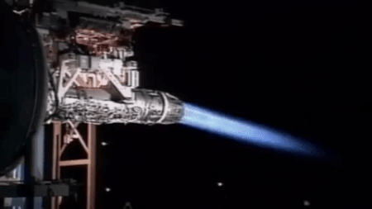
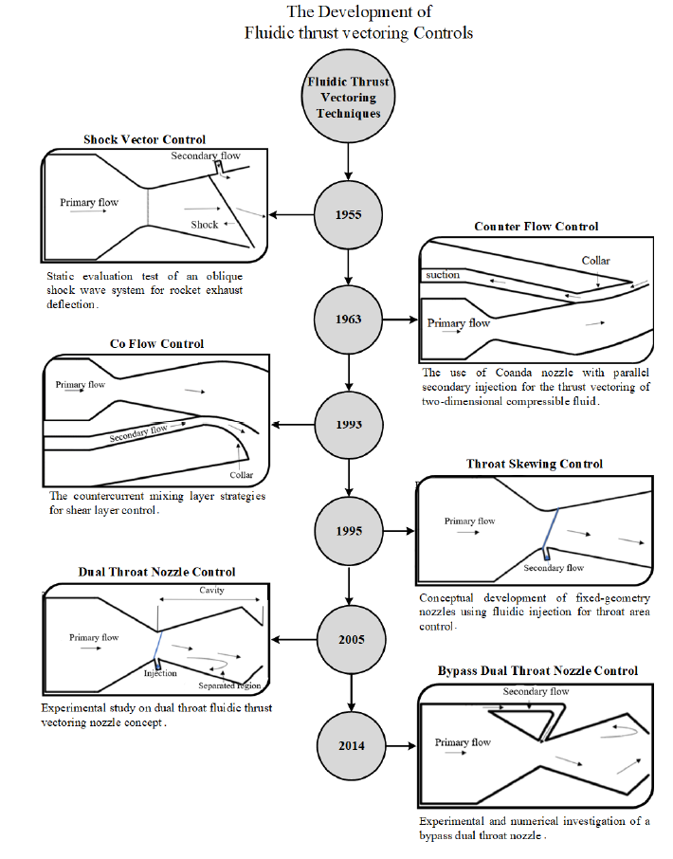
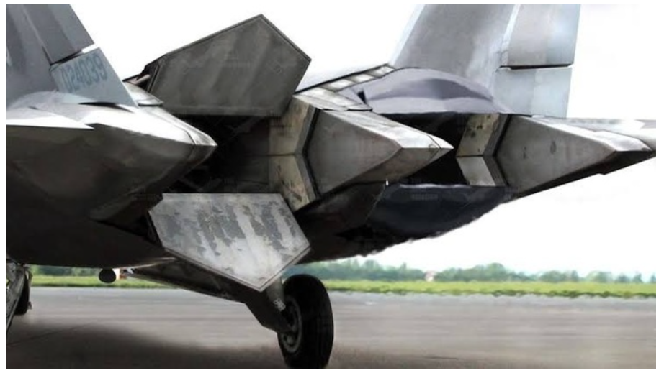
Introduction
Thrust Vectoring Nozzle (TVC)
Mechanical
Fluidic

Slide 5
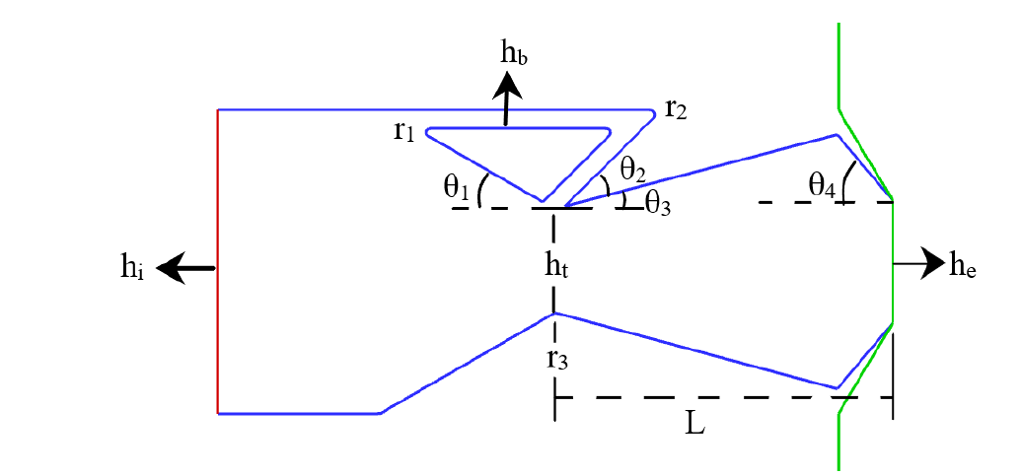
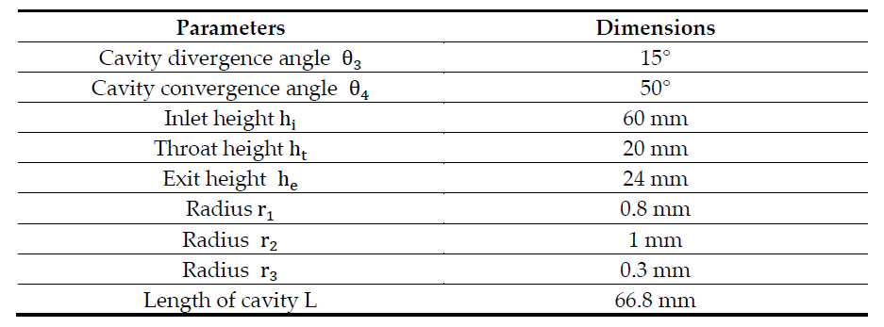
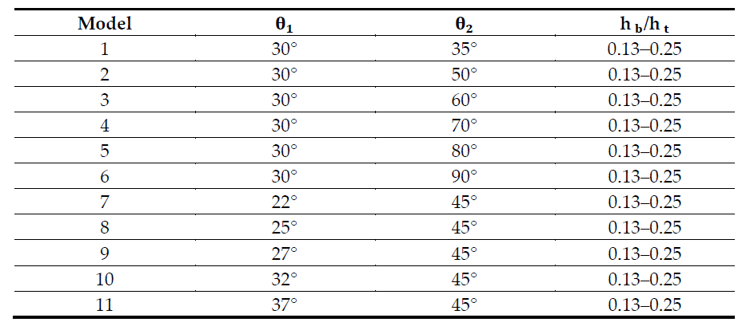
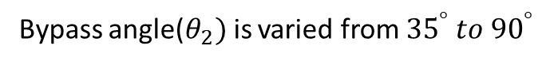
Nozzle configuration
Configuration of BDTN
Constant geometric dimensions and parameters
Models are based on the variation in bypass width
Nozzle convergence angle($θ_{1})$is varied from ${22}^{°} to {37}^{°}$
Bypass angle($θ_{2})$is varied from ${35}^{°} to {90}^{°}$
Ratio of bypass width to throat height($h_{b}/h_{t})$is varied from 0.13 to 0.25
NPR=2-10, all these configuration are studied to investigate the thrust vectoring performance for under-expanded and over-expanded jets

Slide 6
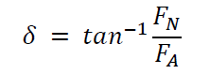
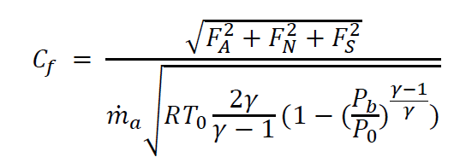
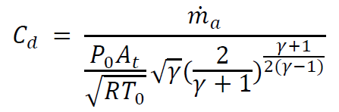
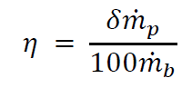
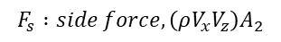
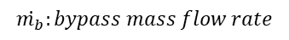
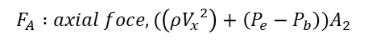
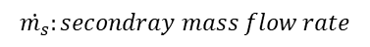
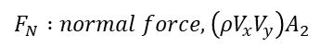
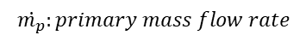
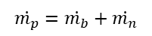
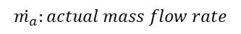
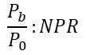
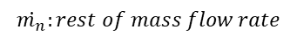
Nozzle configuration
Performance parameters
The performance parameters considered are thrust, discharge coefficients, vectoring angle and efficiency.
Thrust vectoring parameters
Thrust coefficient parameters
Discharge coefficient
$$\dot{m_{a}}:actual mass flow rate$$
$$\dot{m_{p}}:primary mass flow rate$$
$$\dot{m_{p}}=\dot{m_{b}}+\dot{m_{n}}$$
$$\dot{m_{b}}:bypass mass flow rate$$
$$\dot{m_{n}}:rest of mass flow rate$$
$$\dot{m_{s}}:secondray mass flow rate$$
Vectoring efficiency
$$F_{N} :normal force, \left(ρV_{x}V_{y}\right)A_{2}$$
$$F_{A} :axial foce, (\left(ρ{V_{x}}^{2}\right)+\left(P_{e}−P_{b}\right))A_{2}$$
$$F_{s} :side force, \left(ρV_{x}V_{z}\right)A_{2}$$
$$\frac{P_{b}}{P_{0}}:NPR$$

Slide 7
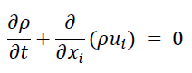
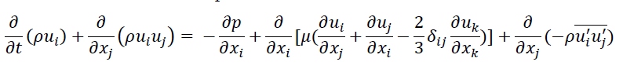
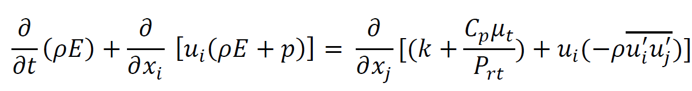
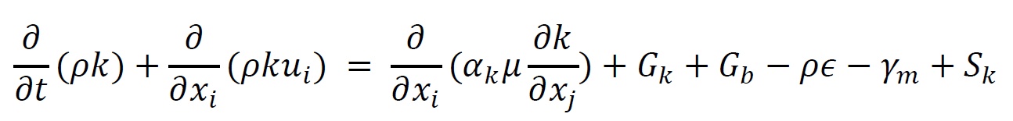
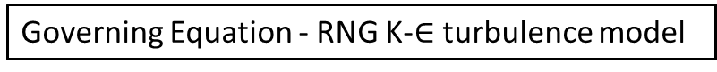
Computational Method
Governing Equation - RNG K-$∈$turbulence model
Continuity Equation
Momentum Equation
Energy Equation
Transport Equation

Slide 8
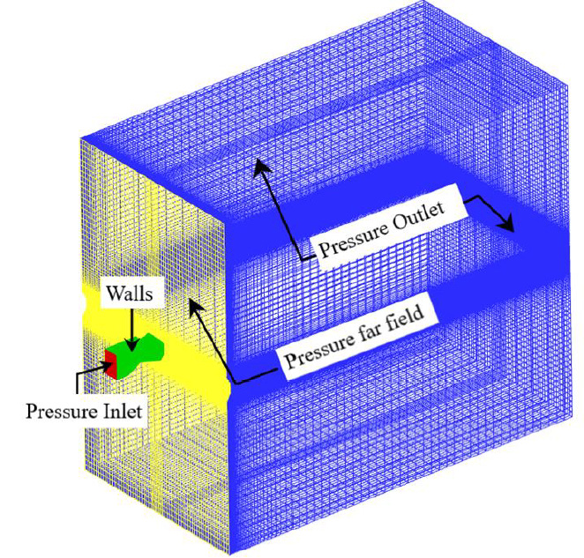
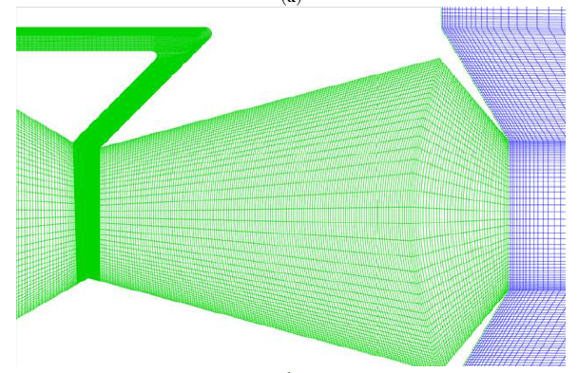
Computational Method
Boundary Conditions
The extended domain is created at the exit of the nozzle
The boundaries of the extended domain are represented as upstream, outlet, and side boundaries
The outlet and side boundaries are stretched by 16, 25, and 10 times the nozzle exit height in the x, y, and z axes, respectively. Pressure inlet boundary condition is applied at the nozzle inlet and pressure outlet is imposed on the downstream boundary of the domain
The no-slip and adiabatic boundary conditions are applied at the nozzle walls
Depending on the design NPR, the total pressure varies as well, as Pt = Pb × NPR. Pressure Pb refers to atmospheric pressure

Slide 9
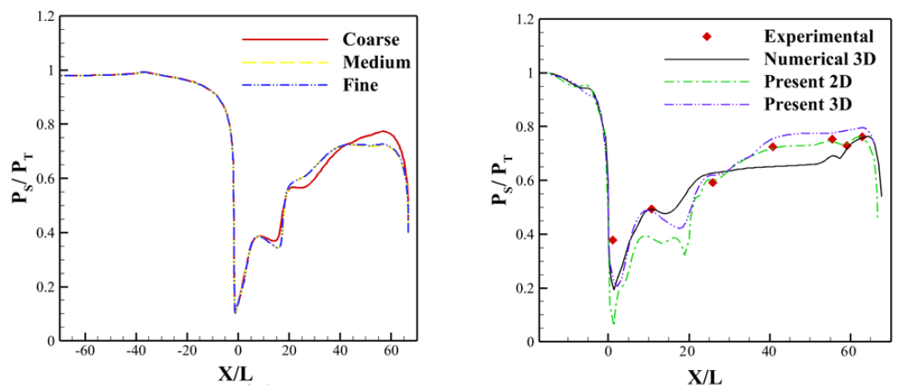
Computational Method
Grid Independence Test
Grid independence analysis is conducted to achieve higher accuracy results using high-density and high-resolution mesh
The results indicate the differential values in static pressure distribution for the coarse grid and the other two grids however static pressure distributions for medium and fine grids demonstrated a difference of 1%
The medium mesh was selected to conduct this study
[static pressure distribution for all three grids]
[Comparing static pressure distribution for the experimental and computational calculations at NPR=3]

Slide 10
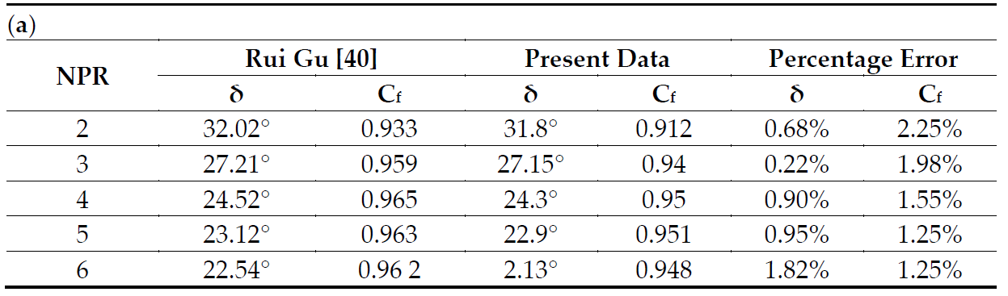
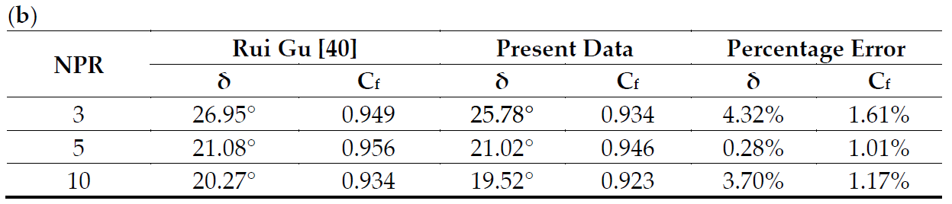
Computational Method
Computational Validation
This work compares computational with experimental data to validate the numerical method and the turbulence model.
Total pressure and temperature applied were 303,975 pa and 300 K
Inlet pressure 303,975 pa and back pressure 101,325 pa

Slide 11
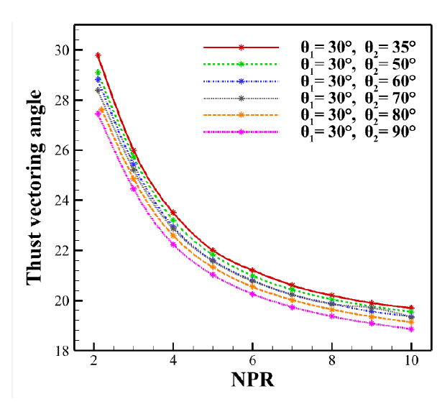
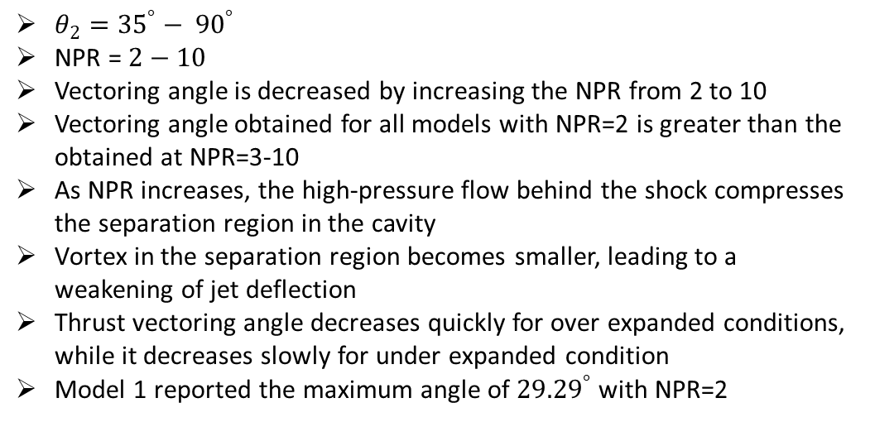
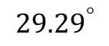
Results
The effect of bypass angle under different NPRs, the effect of bypass width, and the combined effect of bypass angle and bypass width on BDTN performance is discussed
BDTN Performance under different NPR
$${29.29}^{°}$$
$θ_{2}={35}^{°}− {90}^{°}$
NPR = $2−10$
Vectoring angle is decreased by increasing the NPR from 2 to 10
Vectoring angle obtained for all models with NPR=2 is greater than the obtained at NPR=3-10
As NPR increases, the high-pressure flow behind the shock compresses the separation region in the cavity
Vortex in the separation region becomes smaller, leading to a weakening of jet deflection
Thrust vectoring angle decreases quickly for over expanded conditions, while it decreases slowly for under expanded condition
Model 1 reported the maximum angle of ${29.29}^{°}$ with NPR=2

Slide 12
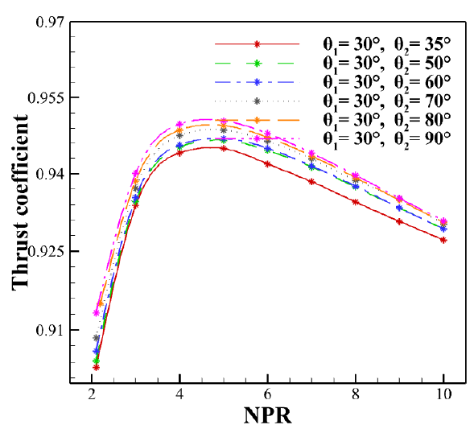
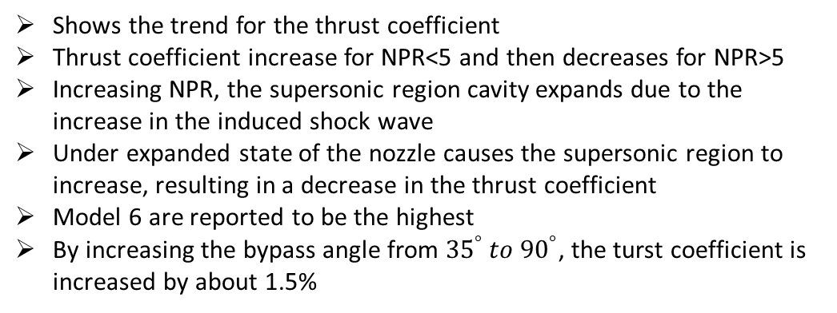
Results
The effect of bypass angle under different NPRs, the effect of bypass width, and the combined effect of bypass angle and bypass width on BDTN performance is discussed
BDTN Performance under different NPR
Shows the trend for the thrust coefficient
Thrust coefficient increase for NPR<5 and then decreases for NPR>5
Increasing NPR, the supersonic region cavity expands due to the increase in the induced shock wave
Under expanded state of the nozzle causes the supersonic region to increase, resulting in a decrease in the thrust coefficient
Model 6 are reported to be the highest
By increasing the bypass angle from ${35}^{°} to {90}^{°}$, the turst coefficient is increased by about 1.5%

Slide 13
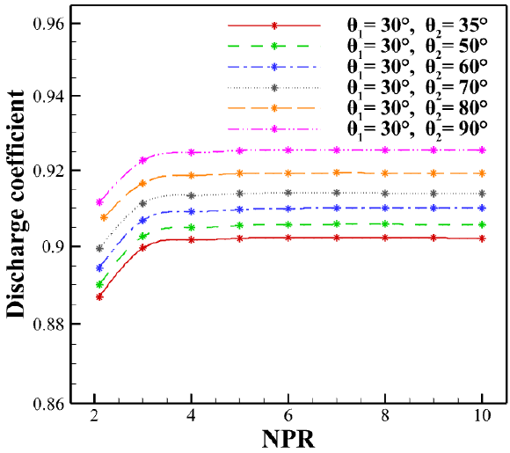
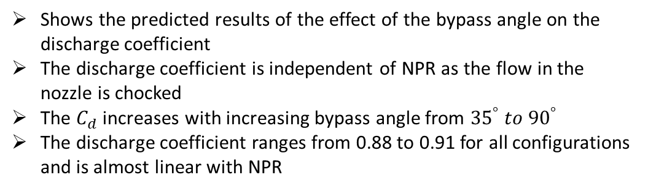
Results
The effect of bypass angle under different NPRs, the effect of bypass width, and the combined effect of bypass angle and bypass width on BDTN performance is discussed
BDTN Performance under different NPR
Shows the predicted results of the effect of the bypass angle on the discharge coefficient
The discharge coefficient is independent of NPR as the flow in the nozzle is chocked
The $C_{d}$ increases with increasing bypass angle from ${35}^{°} to {90}^{°}$
The discharge coefficient ranges from 0.88 to 0.91 for all configurations and is almost linear with NPR

Slide 14
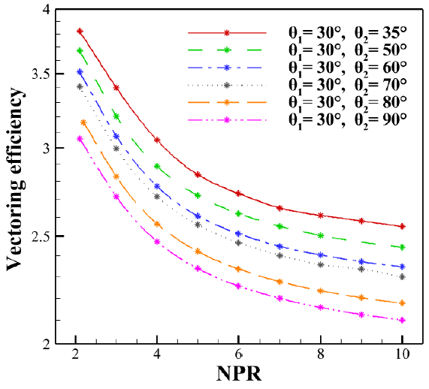
Results
The effect of bypass angle under different NPRs, the effect of bypass width, and the combined effect of bypass angle and bypass width on BDTN performance is discussed
BDTN Performance under different NPR
A decreasing trend for vectoring efficiency as the NPR increases from 2 to 10
Model 1 has the highest thrust efficiency of η=3.72 at NPR=2

Slide 15
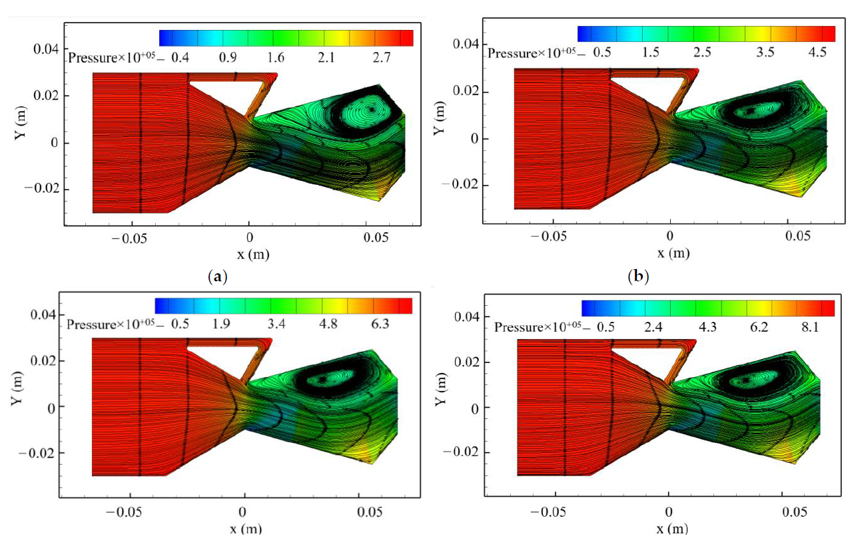
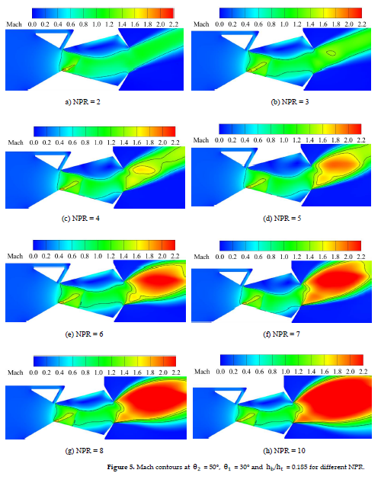
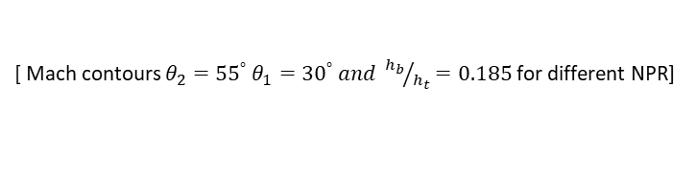
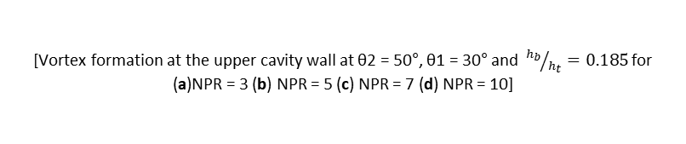
Results
[Vortex formation at the upper cavity wall at θ2 = 50°, θ1 = 30° and ${h_{b}}/{h_{t}}=0.185$for (a)NPR = 3 (b) NPR = 5 (c) NPR = 7 (d) NPR = 10]
Represents the Mach contours for different NPR
Due to secondary flow interaction with the primary flow, normal and oblique shocks are formed in the cavity of the nozzle
The supersonic flow changes properties across normal shock and become subsonic
Vortex zone in the cavity reduces as the induced shock diminishes with increasing NPR
The vortex zone near the nozzle exit increases with initial NPR and decreases with increasing NPR
By expanding and deflecting the primary flow, the subsonic flow generates thrust vectoring angles
By increasing the NPR, the efficiency of the vortex decreases, thereby reducing the vectoring angle
[ Mach contours $θ_{2}={55}^{°} {θ_{1}=30}^{°} and {h_{b}}/{h_{t}}=0.185$for different NPR]

Slide 16
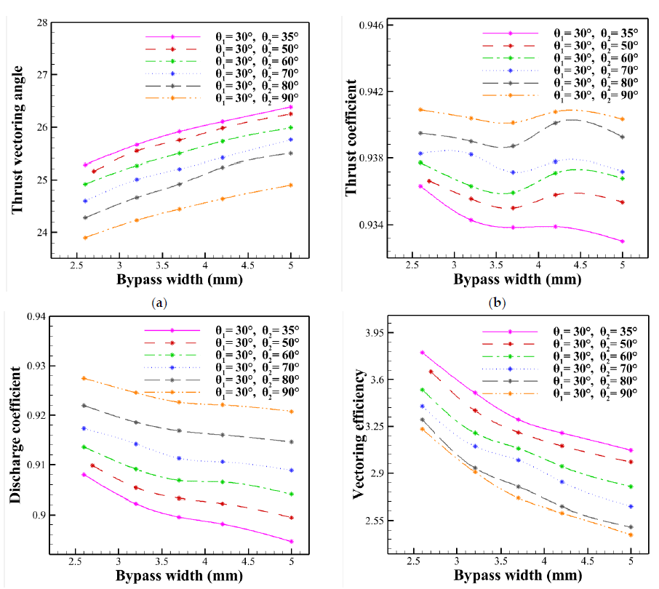
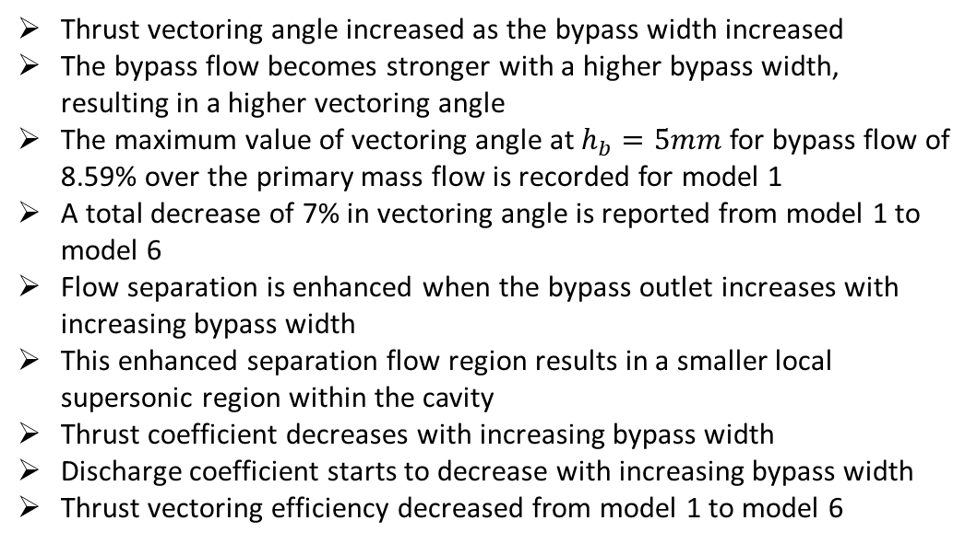
Results
The effect of bypass angle under different NPRs, the effect of bypass width, and the combined effect of bypass angle and bypass width on BDTN performance is discussed
BDTN Performance under different Bypass Width
Thrust vectoring angle increased as the bypass width increased
The bypass flow becomes stronger with a higher bypass width, resulting in a higher vectoring angle
The maximum value of vectoring angle at $h_{b}=5mm$ for bypass flow of 8.59% over the primary mass flow is recorded for model 1
A total decrease of 7% in vectoring angle is reported from model 1 to model 6
Flow separation is enhanced when the bypass outlet increases with increasing bypass width
This enhanced separation flow region results in a smaller local supersonic region within the cavity
Thrust coefficient decreases with increasing bypass width
Discharge coefficient starts to decrease with increasing bypass width
Thrust vectoring efficiency decreased from model 1 to model 6

Slide 17
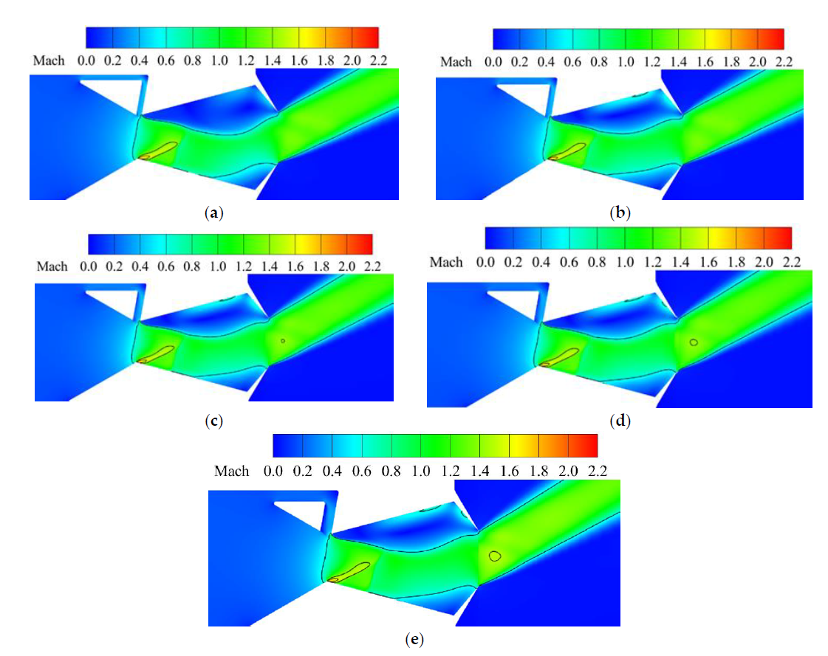
Results
At the nozzle exit, lower bypass widths result in higher static pressure, while higher bypass widths result in lower static pressure
Higher static pressure and lower bypass width tend to cause the thrust vectoring angle to decrease while vectoring efficiency, discharge and thrust coefficient is increased
particular bypass width, increasing the bypass angle decreases thrust vectoring angle but the thrust coefficient increases. In addition to a 4% increase in vectoring angle, a 19%, 0.9%, and 0.1% decrease in vectoring efficiency, discharge, and thrust coefficient were observed with an increase in bypass width
[Mach contours on the center-plane at NPR = 3, θ2 = 70° and θ1 = 30° for bypass width of (a) 2.7 mm (b) 3.2 mm (c) 3.7 mm (d) 4.2 mm (e) 5 mm]

Slide 18
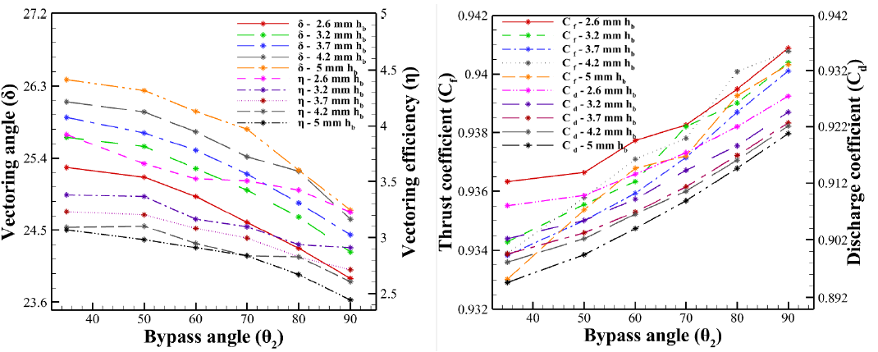
Results
Combined Effect of Bypass Width and Bypass Angle
Increasing the bypass angle and decreasing the bypass width resulted in a decrease in vectoring angle
On the other hand, vectoring efficiency revealed a decreasing trend
As the bypass angle and width increase the thrust coefficient decreases
Discharge coefficient shows a similar trend
Increasing the bypass width along with bypass angle resulted in decreasing discharge coefficient

Slide 19
Conclusions
NPR significantly affects the thrust vectoring performance of BDTN. As NPR increases, the squeezing effect of the vortex in the cavity reduces, which reduces the supersonic region within the nozzle. Because the vortex size and supersonic region are reduced, BDTN has a lower thrust vectoring performance
As bypass width influences vectoring angle, increasing bypass width increases the vectoring angle due to increased mass flow. However, a reduction in vectoring efficiency, thrust, and discharge coefficient is obtained to reach a higher vectoring angle. It is found that a bypass width of 3.7 mm is an optimal choice for effective vectoring performance
The bypass angle is an important factor in generating effective vectoring angles. Increasing the bypass angle and decreasing the bypass width resulted in an increase in the thrust and discharge coefficient and a decrease in vectoring angle. Optimal vectoring performance is achieved with a bypass angle of 35°

Slide 20
Thank you

